Slide 1
Object detection with machine learning

Slide 2
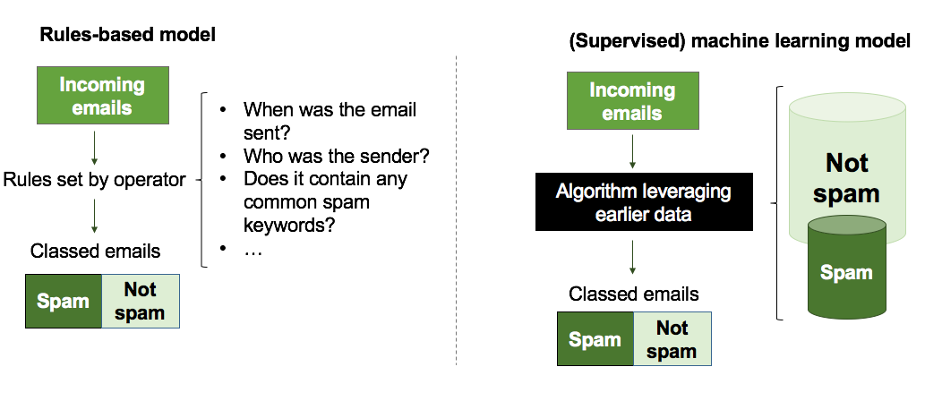



why we need machine learning ?
Resolve problems for which existing solutions require a lot of hand-tuning or long list of rules
Complex problems for which there is no good solution at all using a traditional approach. Machine Learning can help to find solution.

Slide 3

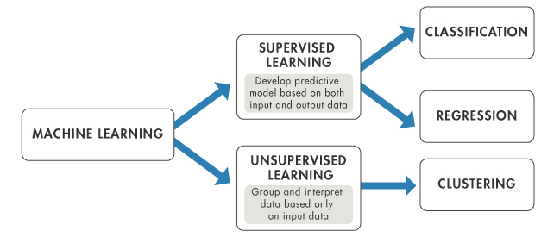

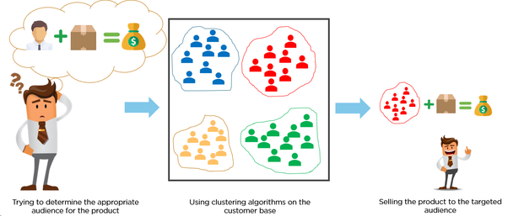
categories of machine learning
Notes:
Centralized error data collected from production quality control team (PQC), outcome with reports

Slide 4


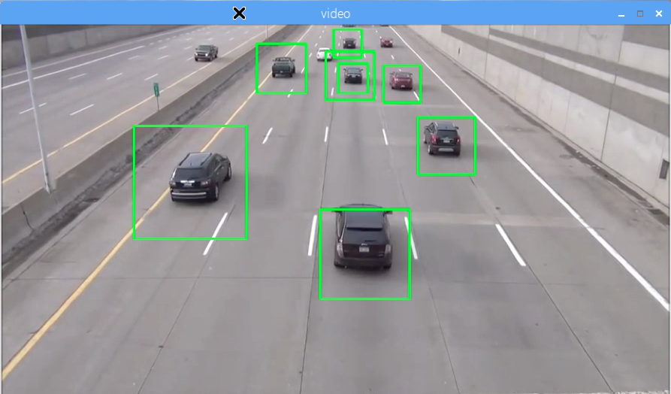
what is object detection ?
Notes:
Centralized error data collected from production quality control team (PQC), outcome with reports

Slide 5
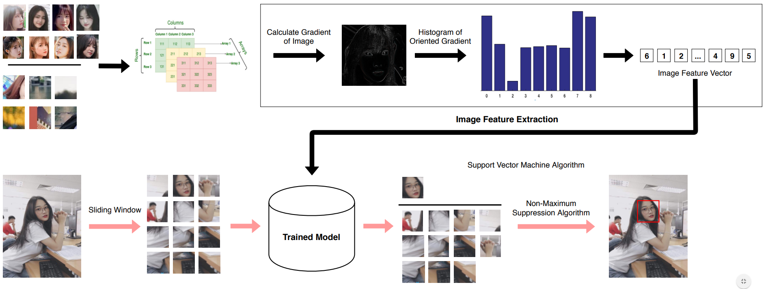
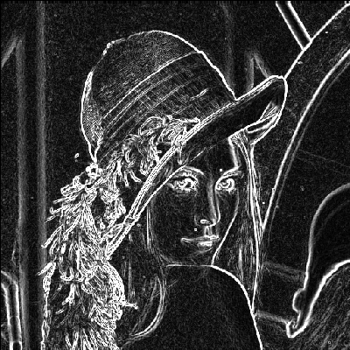
how Object detector works ?
Notes:
Centralized error data collected from production quality control team (PQC), outcome with reports

Slide 6

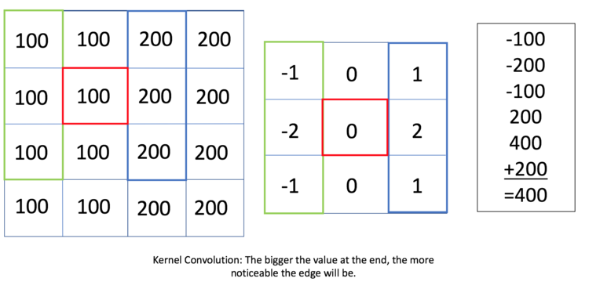
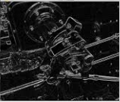
Feature extraction Histogram of oriented gradient
1. What is gradient ?
- Gradient of Image is a direction of change in the intensity or color in an image.
2. Edge Detection and Sobel
- Edge Detection is a image processing technique for finding the boundaries of objects within images. It works by detecting discontinuities in brightness.
- Sobel works by calculate gradient of each pixel of image. Therefore, we can see how abruptly or smoothly the image change at each pixel. Because of that, we can consider some pixels represent an edge.

Slide 7
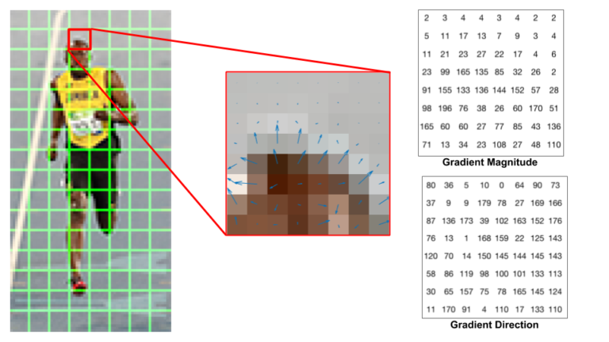
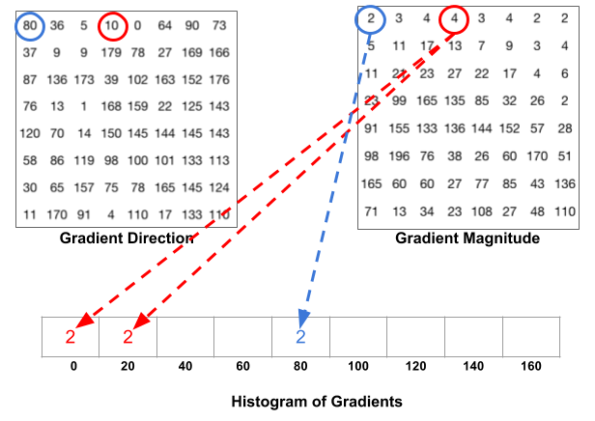
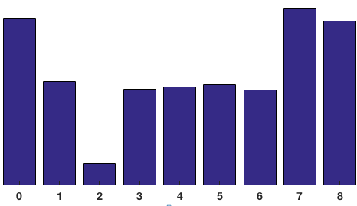
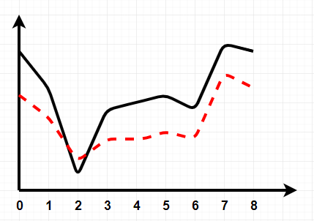
Feature extraction Histogram of oriented gradient
3. Histogram of Gradient

Slide 8
Feature extraction Histogram of oriented gradient
4. Block Normalization
- Gradients of an image are sensitive to overall lighting.
- [128, 64, 32] is RGB color vector => length of vector = = 146.64
- Dividing each element of this vector by 146.64 gives us a normalized vector [0.87, 0.43, 0.22].
- [256, 128, 64] = 2 * [128, 64, 32] after normalize, we still get [0.87, 0.43, 0.22]
- With this idea, we can concatenate 4 histograms = 4 * 9 bins. With this, we has a 36 dimensions vector
5. Calculate the HOG feature vector
- To calculate the final feature vector for the entire image patch, the 36×1 vectors are concatenated into one giant vector.

Slide 9

Sliding window

Slide 10
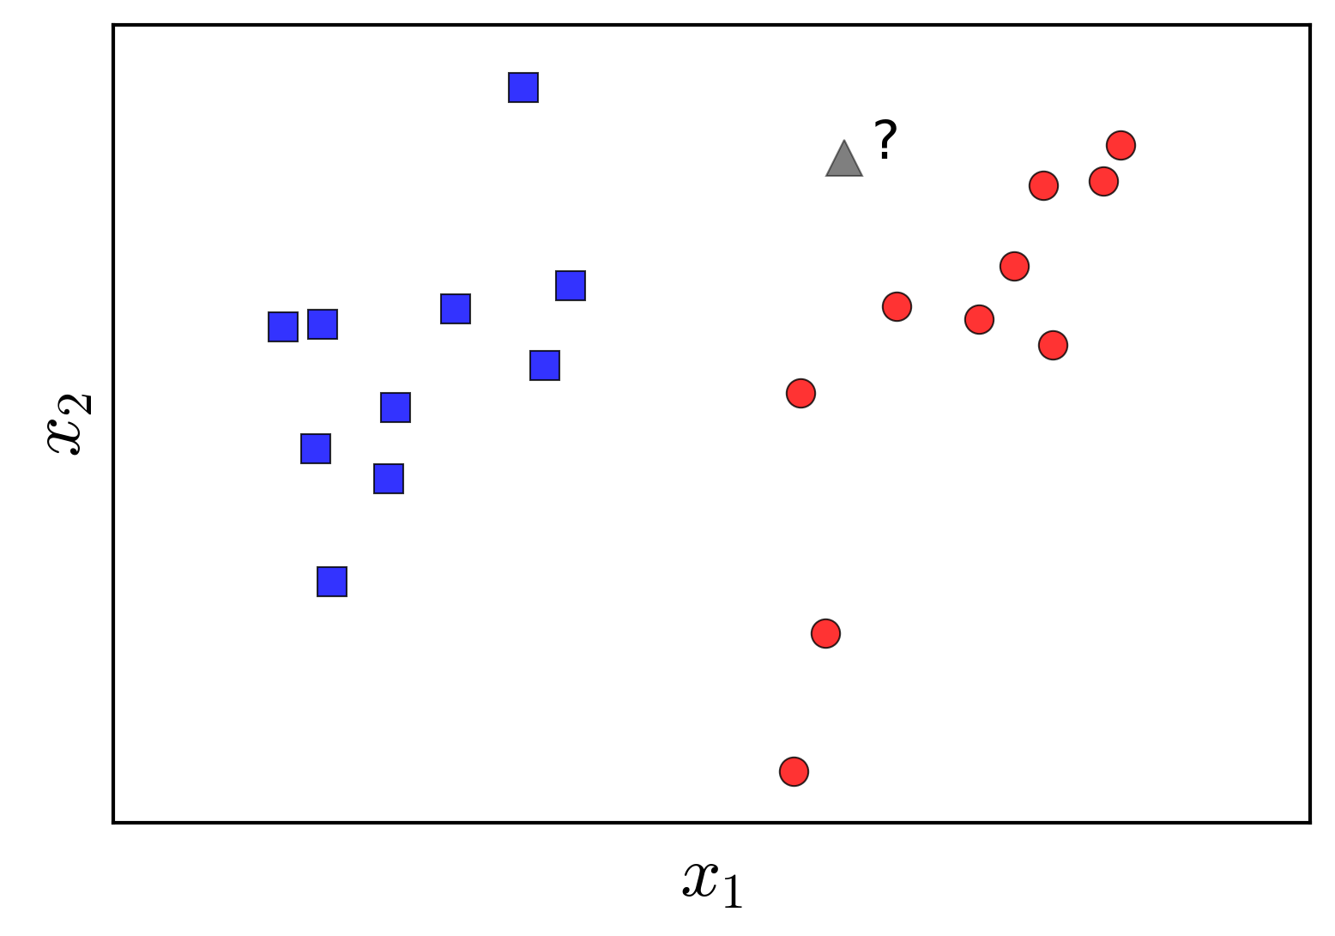
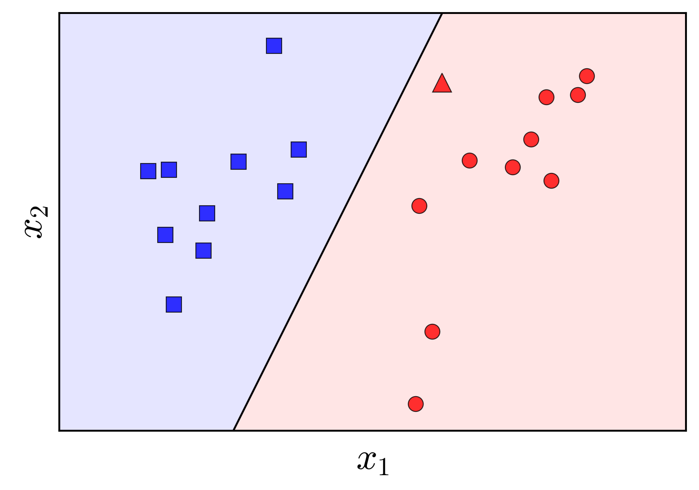
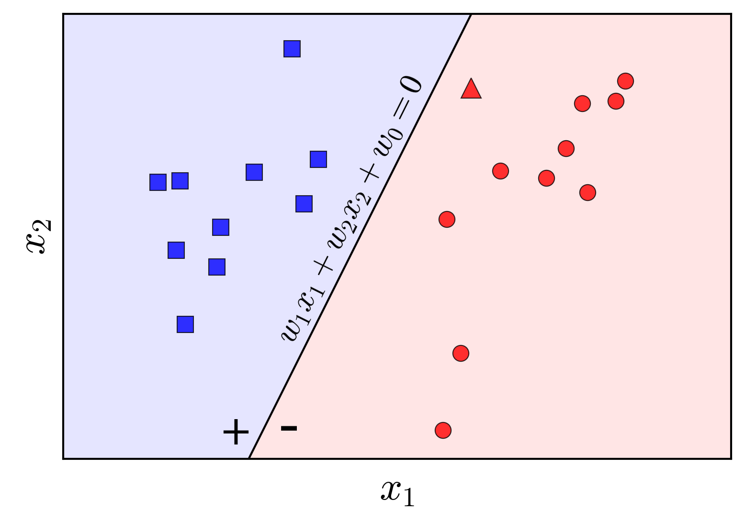
Classification Perceptron algorithism
f(x) = w₁x₁ + w₂x₂ + ... + w_{n}x_{n} là phương trình của siêu mặt phẳng phân chia 2 class xanh và đỏ.
Với w được generate random lúc đầu, trong mỗi lần lặp, ta thế x vào phương trình trên để tính được f(x)
Khi đã tính được f(x), ta dùng cost function để xác định độ chính xác của w
Cost function được dùng là
Ta thế f(x) đã tính được và y (label) vào công thức RMSE, ta sẽ biết được w cần phải tăng hay giảm để phù hợp với bộ dữ liệu
Khi nghiệm của hàm RMSE là thấp hơn mức chúng ta cần, thì xem như model đã được train thành công.

Slide 11
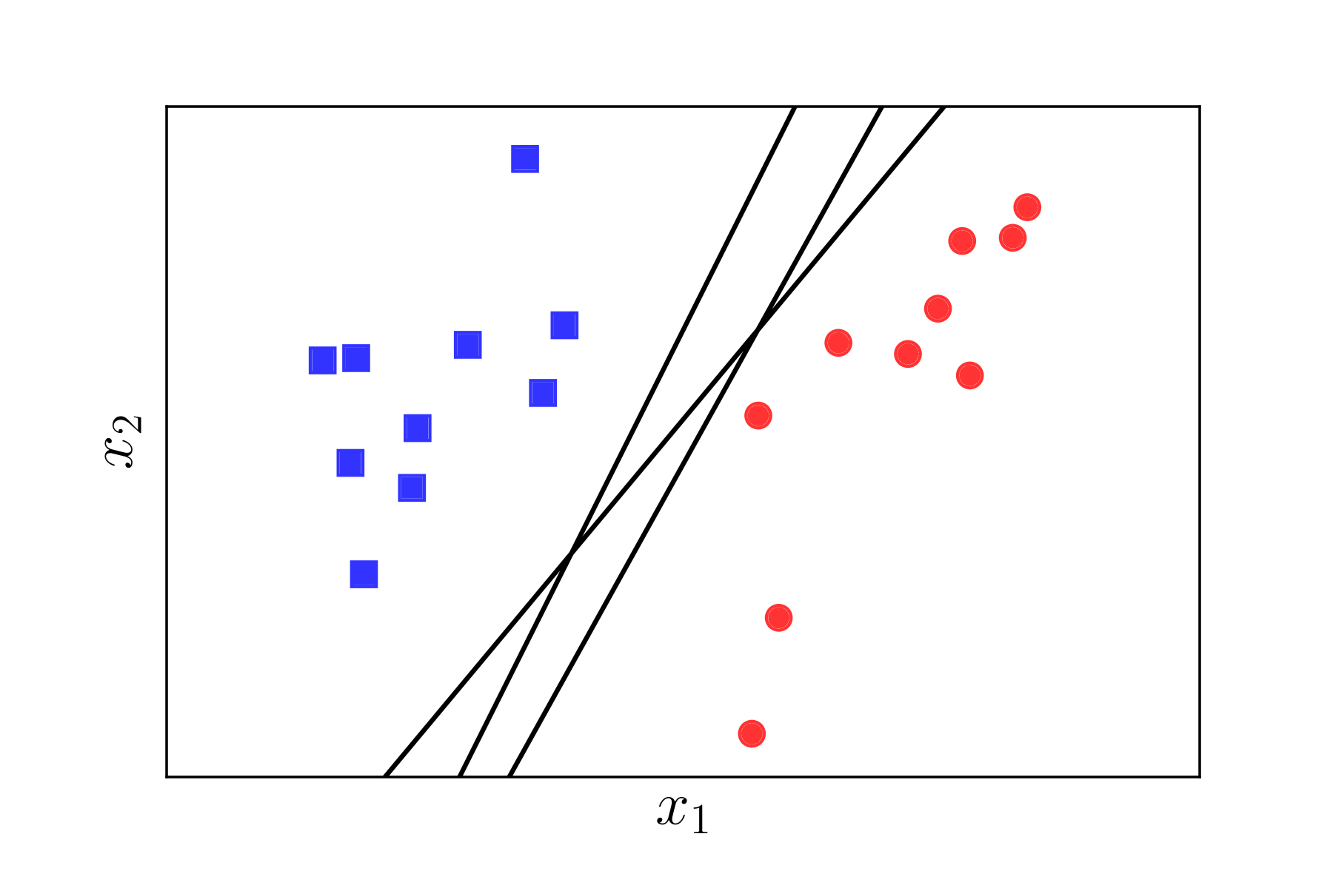
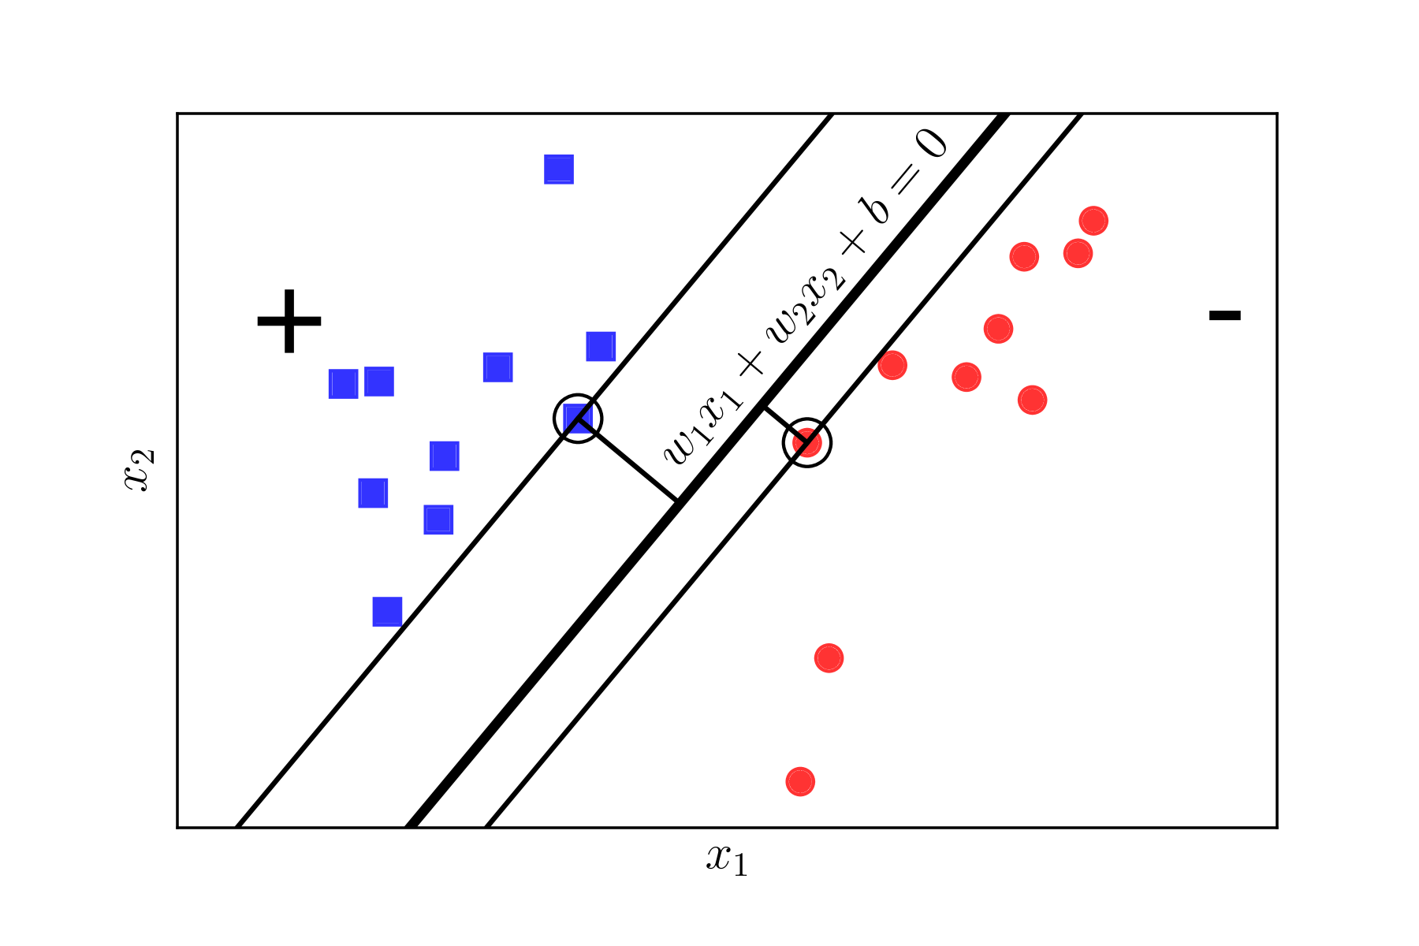
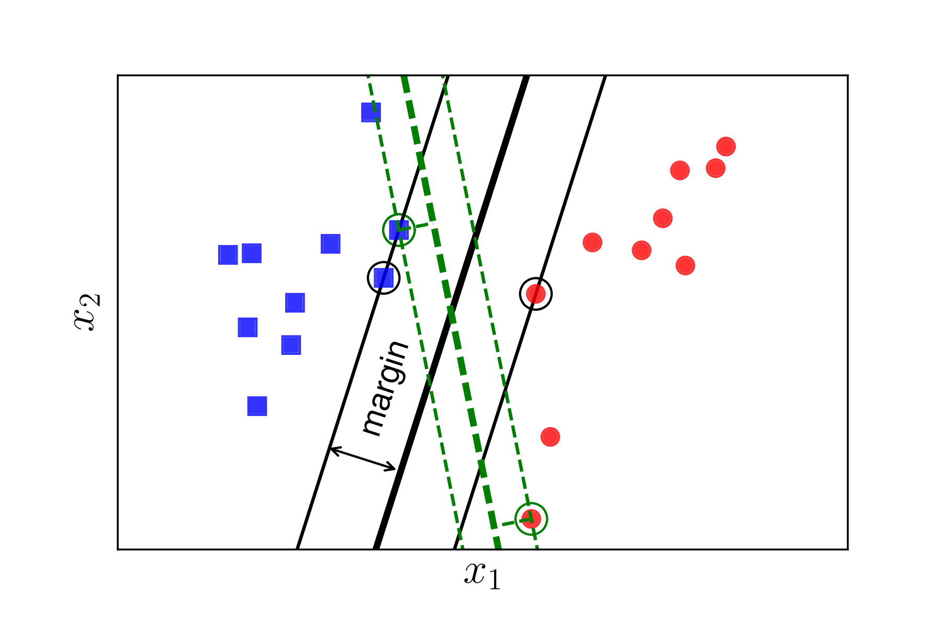
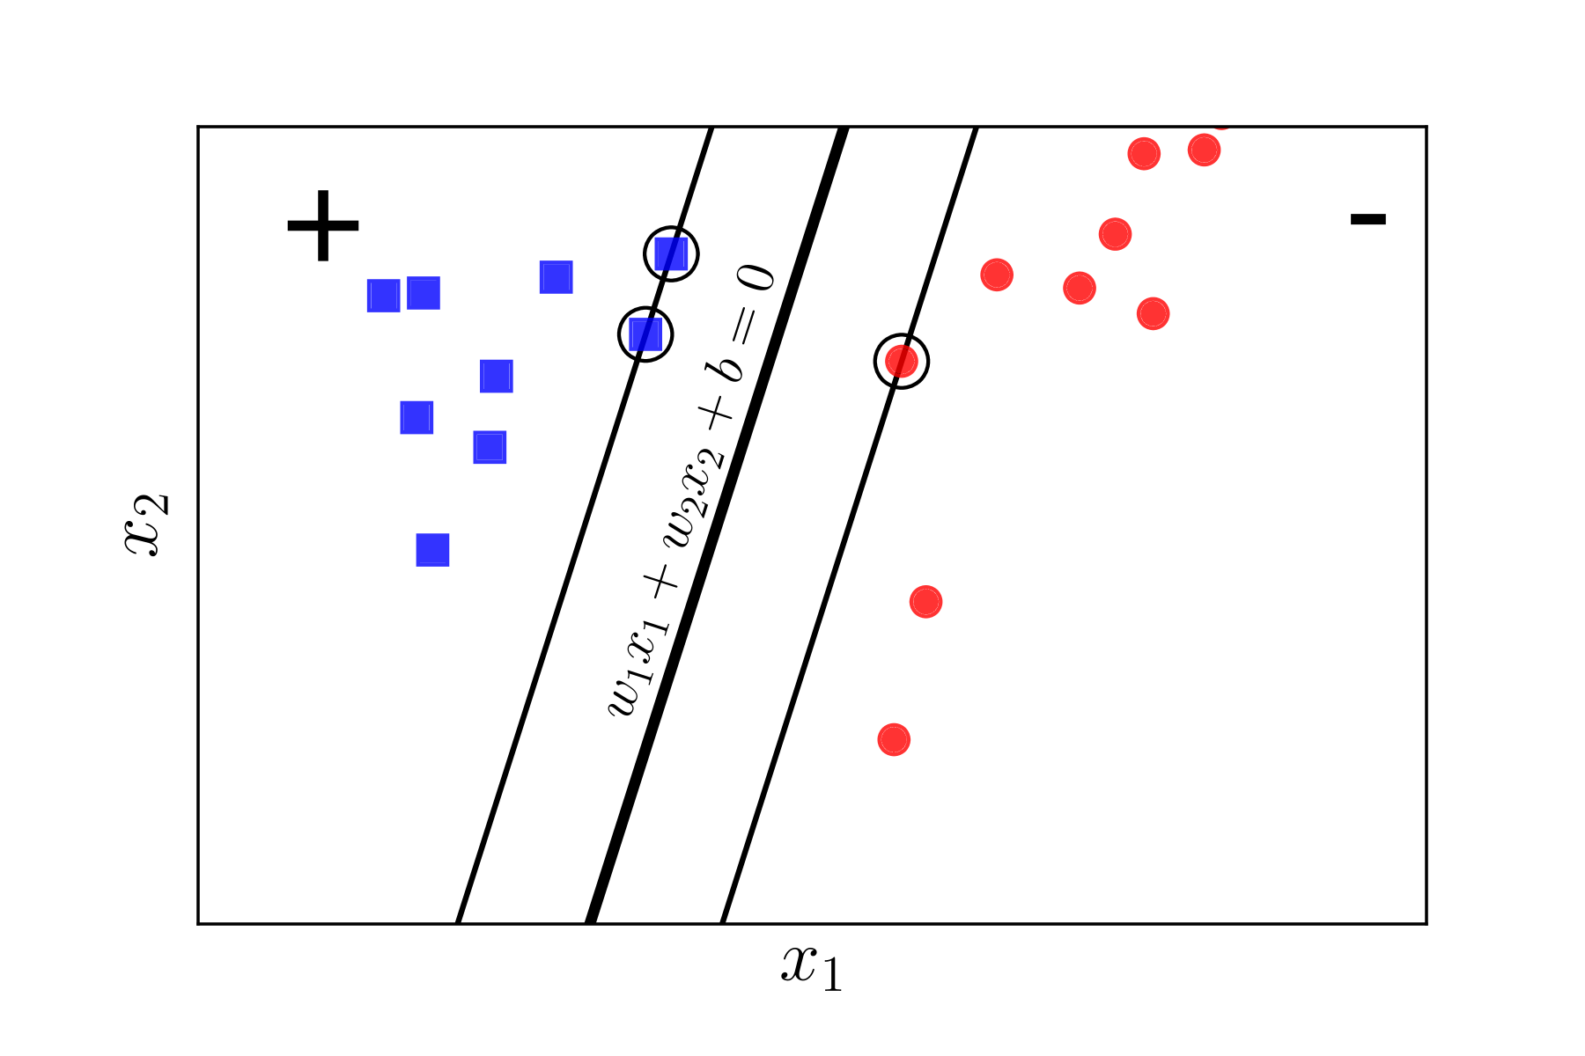
Classification Support Vector MAchine

Slide 12
Q & A

